Slide 1

Power Analyzer
Intuitive data visualization and em-POWERing insights.
Nathan Zimmerly (Advisor: Rob Frohne)

Slide 2
What is the Power Analyzer?
A device and service that aims to lower power consumption through intuitive data visualization

Slide 3
Goals
Requirements
Build an embedded device for data collection
Store data from embedded device
Display information online
Event Notifications
Ideal goals
Authentication
Electric bill prediction
In-depth data analysis
Export data feature

Slide 4
Old Schedule
Dec 17, '17
Jan 14, '18
Feb 11, '18
Mar 11, '18
Apr 8, '18
May 6, '18
Designing embedded module - Nathan 11/29/17 - 2/12/18
Frontend – Ryan & Nathan 2/16/18 - 4/5/18
Design review 4/6/18 - 4/12/18
Design revision 4/13/18 - 4/26/18
Draft report 4/27/18 - 5/3/18
Presentation 5/4/18 - 5/10/18
Report 5/11/18 - 5/15/18
Poster 5/16/18 - 5/22/18
Backend - Ryan 11/29/17 - 2/26/18

Slide 5
Schedule
Dec 17, '17
Jan 14, '18
Feb 11, '18
Mar 11, '18
Apr 8, '18
May 6, '18
Designing embedded module (Revisions 1 & 2) - Nathan 11/29/17 - 4/5/18
Design review 4/6/18 - 4/12/18
Design revision 4/13/18 - 4/26/18
Draft report 4/27/18 - 5/3/18
Presentation 5/4/18 - 5/10/18
Report 5/11/18 - 5/15/18
Poster 5/16/18 - 5/22/18
Backend - Ryan 11/29/17 - 3/1/18
Frontend – Ryan 3/1/18 - 4/26/18

Slide 6
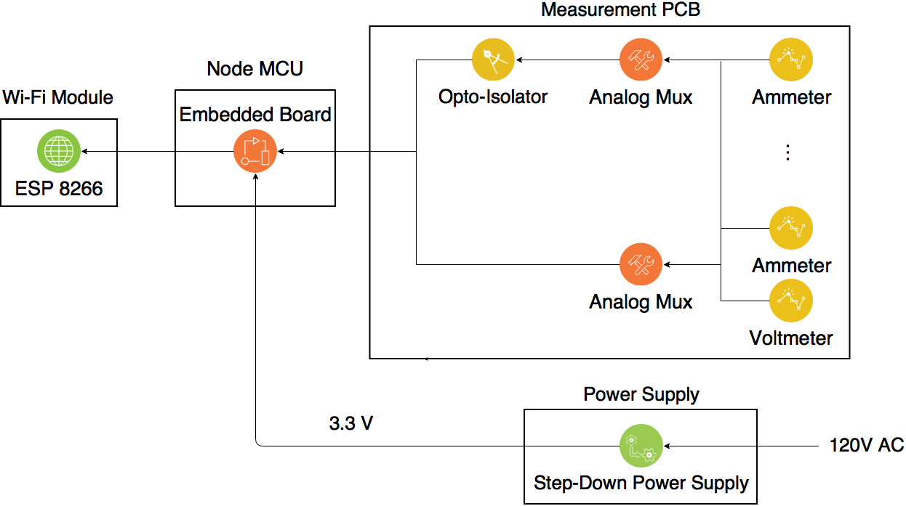
Block Diagram (Rev. 1)

Slide 7
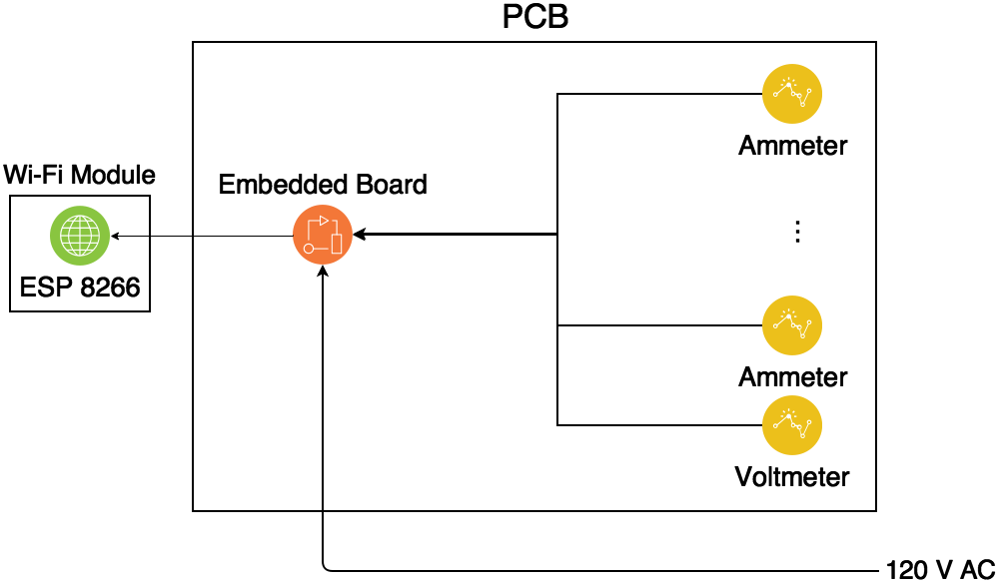
Block Diagram (Rev. 2)

Slide 8
Current and Voltage Measurement
1st Design:
OP-AMP
2nd Design:
Inductor
3rd Design:
High Resistance Voltage Divider

Slide 9
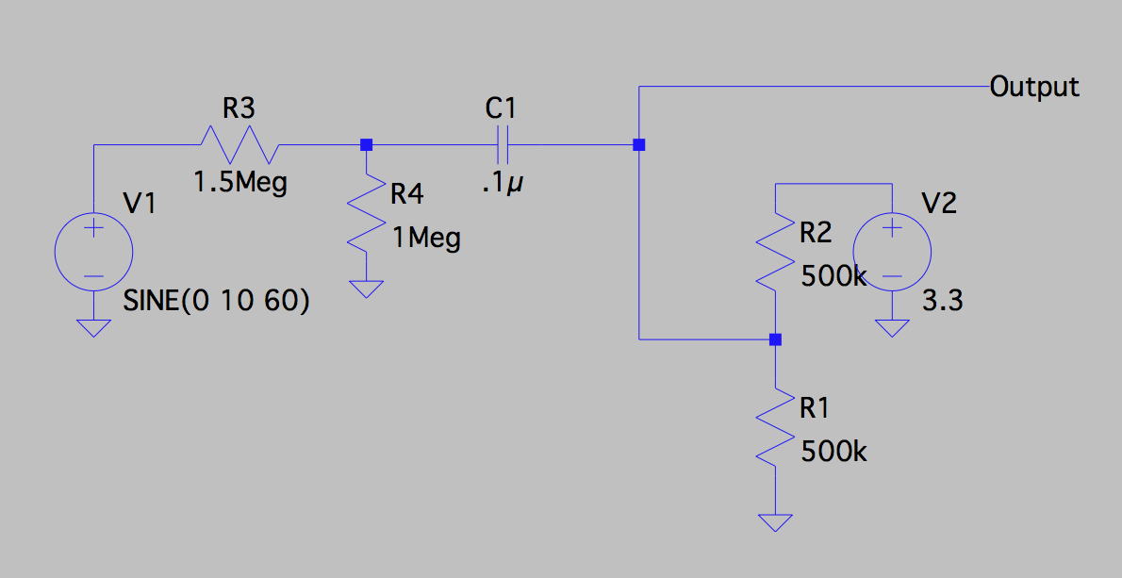
V and I Measurement – High Resistance
Notes:
Inductor
Difference between V and I
Fuse

Slide 10
Phase Measurement
Opto-Isolator turns sine input into a square wave.
Measuring the time difference between voltage rise and current rise allows me to calculate the power factor.

Slide 11
Parts – Embedded Board: Node MCU
Price: $2.85
Includes an A-D Converter
Includes Wi-Fi Chip (Unnecessary now)

Slide 12
Parts: Wi-Fi Module: ESP 8266
The same Wi-Fi Module used on the Node MCU

Slide 13
Parts – Analog Mux:
Digi-Key Part #: 296-9226-1-ND
Voltage Range: 2-6V
Multiplexer Circuit: 16:1
Price: $.38

Slide 14
Parts – Opto-Isolator
Digi-Key Part #: 160-1794-2-ND
Reverse Voltage: 5V
V_{DD} Max: 7V
Input Forward Voltage: 1.45-1.7V
Price: $.94

Slide 15
Parts – Power Supply: Buck Converter Step Down Module
90 - 240 V AC input voltage
DC 3.3 V Output
Cost: $1.45

Slide 16
Software
PlatformIO – Arduino Framework
Efficiency:
Maximizing testing time by sending 15 second averages.
Preforming calculations on Server.

Slide 17
Questions or Suggestions?

Slide 18
Power Analyzer
Intuitive data visualization and em-POWERing insights.
Ryan Rabello (Advisor: Rob Frohne)

Slide 19
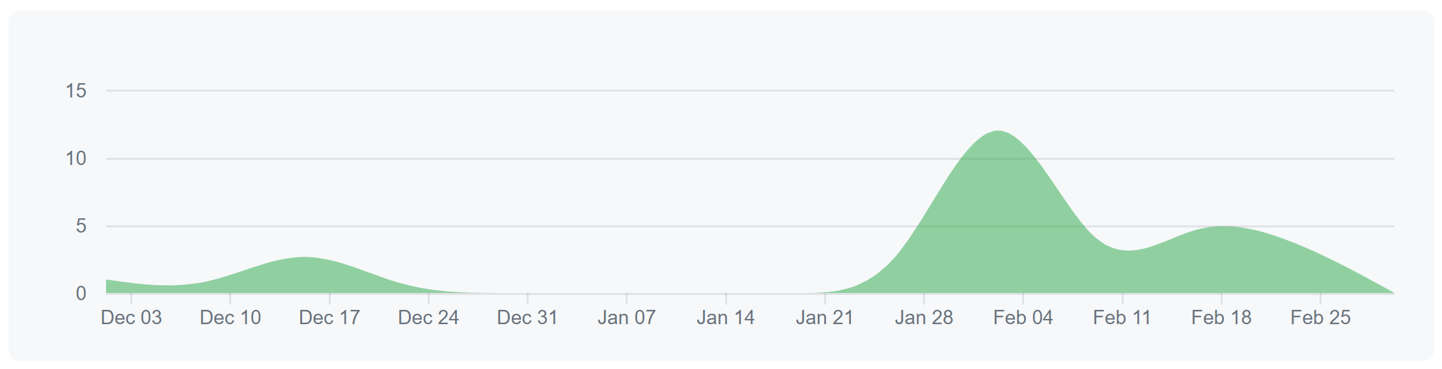
Backend
Define Database Models
Defining API Endpoints
Put preliminary server into production

Slide 20
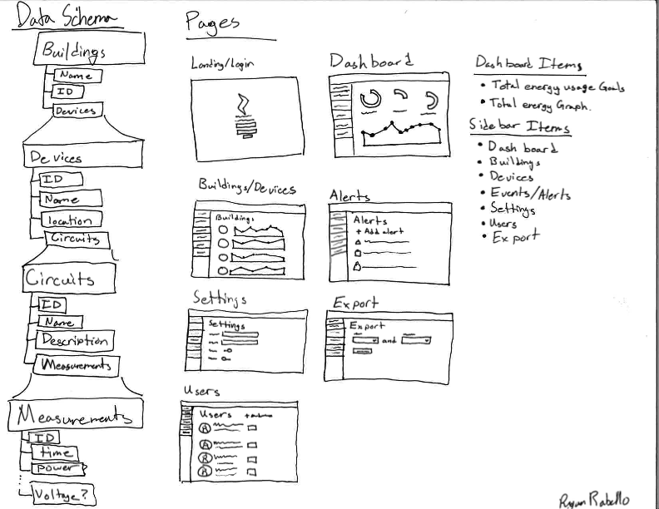
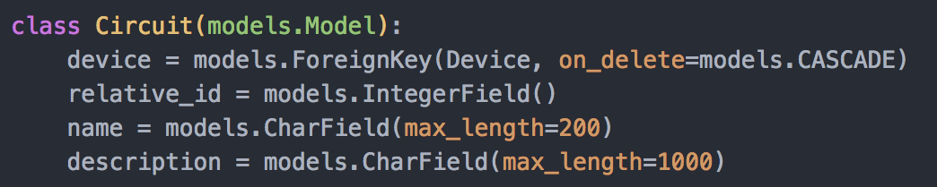
Database Models
Model form
Django models are really easy.
Django migrations are nice.
Archiving scheme.
Without loosing accuracy

Slide 21
API Endpoints
Endpoints
Single upload
Register
Batch upload
Batch Upload
Can accept one measurement
Triggers Archive
Registers a device if it hasn’t been created already.
URL | Method | Description | Request body (IF POST) | Response body
/datapoints/register/<str:mac> | GET | This will create a new Device object with the given mac address if it doesn’t already exists. | N/A | {"mac": <device.mac>}
/datapoints/<str:mac>/batch/ | POST | This will upload one measurement to a number of circuits. The server will save “power”, “voltage”, “current” and “phase” if they are provided. | {"measurements":[ {"circuit_id": 1, "power": 123, "voltage": 120, "current":10, "phase":0 }, … ]} | {"status":"success"}

Slide 22
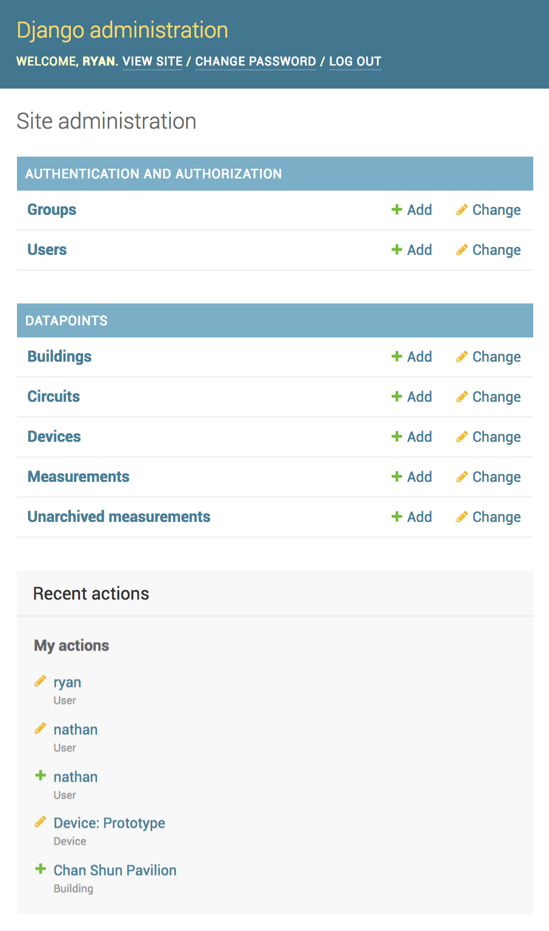
Production Server
Currently running in Matt’s dorm room.
Soon to be put on AWS.
Uses uwsgi for nginx integration.
A prototype device is currently sending data to the server.
http://172.16.38.103/admin

Slide 23
Frontend
Framework Decision
React Native vs React JS
Page Design
Page Navigation

Slide 24
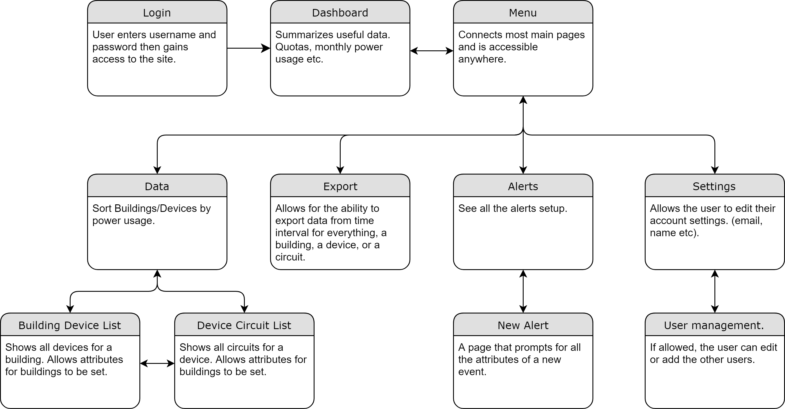

Slide 25
Past, Present, and Future Tasks
Start React Project
Design templates for Pages (Current)
Build Endpoints for various Pages
Add functionality to Pages
Viewing & calculating data
Changing settings/Information about Devices
Exporting data
Managing Alerts (Email Notifications)
Managing Users

Slide 26
Questions or Suggestions?

